Slide 1
Incorporating lived experiences into the development of a dental pain reduction intervention for those living with dementia
Dr. Carrie Stewart
University of Aberdeen

Slide 2
Pain & Dementia
Dementia is an umbrella term for a collection of diseases that negatively affect cognitive function
Approximately half of persons living with dementia experience daily pain (considered higher in care home settings)
Pain assessment challenging
Observational pain assessment tools often poorly used- lack of time, training or confidence to use
Expected that chronic pain is under-reported and under-treated in those living with a dementia
Notes:
Why explore lived experiences
State of dental pain

Slide 3
Oral Health, Dental Pain & Dementia
Around 20% of care home residents have dental pain and oral health of older people with/without dementia is generally poor
Dementia increases difficulty of accessing already stretched dental services
Some progress following NICE Oral Health Guideline (NG48, 2016) : CQC 2023 reports:
Oral health knowledge in care homes increased from 61% to 91%
But 40% of staff have received NO oral health training
The oral health of older people living with dementia is under researched and supported by PPI (Schofield et al, 2022).

Slide 4
Dementia and Dental Pain Recognising Pain in Care Homes: A Sign of Dental Disease
12-month project ending July 2023, funded by Pearn Charitable Trust
Led by the University of Plymouth Institute of Health and Care Research
To identify solutions for the identification, assessment and management of dental pain in persons living with dementia
Notes:
Why explore lived experiences
State of dental pain

Slide 5
Approach & Methods
Design- An online discussion group involving caregivers of persons living with dementia
Recruited through PPIE networks in the fields of dementia, dentistry and ageing health across the UK
A total of ten caregivers attended from across the U.K.
Semi-structured topic guide:
Dental experiences
Issues, challenges and mouthcare concerns
Thoughts and opinions about a proposed dental pain risk assessment tool
Thematic analysis of conversations and researchers notes
Notes:
: Informed by discussions with a prominent PPI representative in the field of caring for persons with dementia, and a prior multi-disciplinary stakeholder event, a discussion involving ten caregivers of individuals with dementia was conducted. Caregivers were invited from different regions of the U.K., with seven joining an online group discussion and three engaging in one-on-one conversations. Transcripts of the conversations based on three topics of discussion (dental experiences, dental challenges and thoughts on a dental pain risk assessment tool) were analysed using thematic analysis to inform a proposed co-developed model of an intervention which can improve dental care for those living with dementia. Name PPI groups/ GUIDE platform recruited from

Slide 6
The challenges of present dental care
Ability to provide mouth care
Recognising & communicating pain
Access to dental services
External support
Access to educational & training
Carer burden
Notes:
Caregivers reported experiencing a number of challenges in relation to providing oral health care at home and in accessing dental care services.

Slide 7
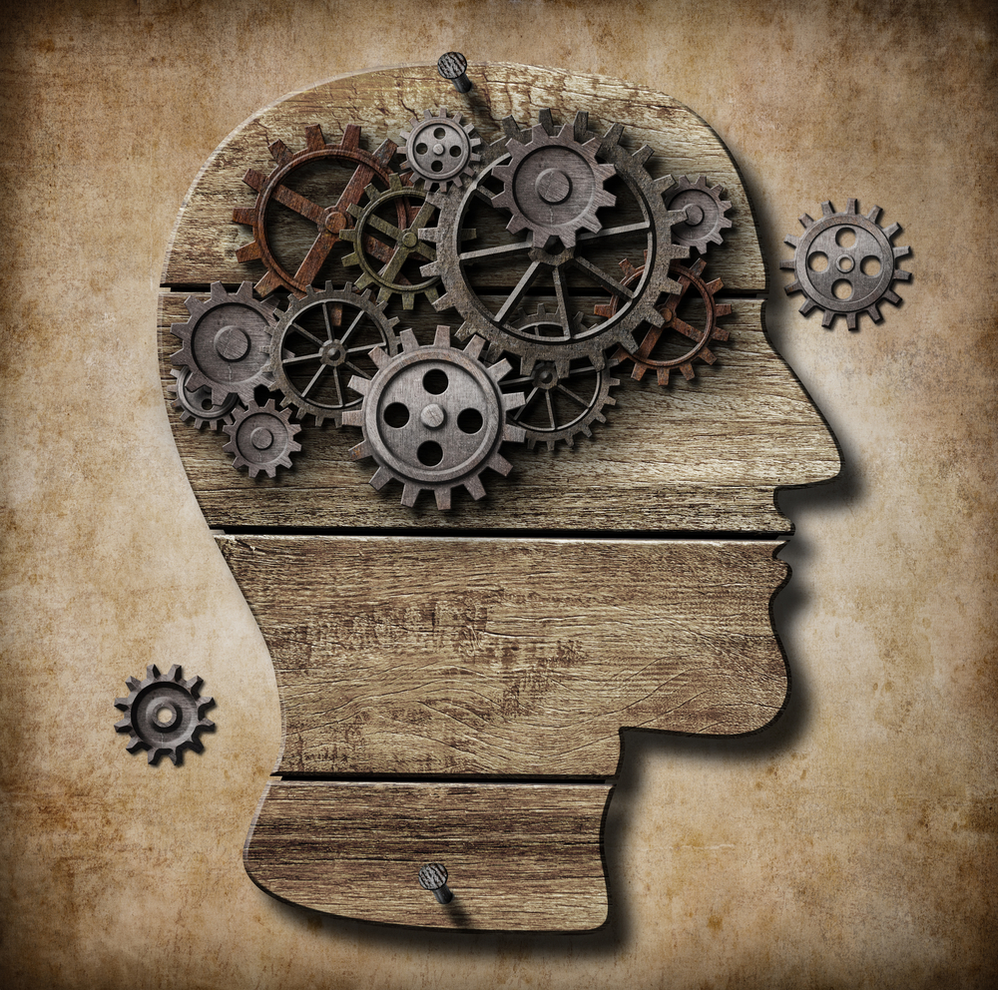
Challenge: Supporting Preventative Care
Intervention needs to:
Accommodate the individual living with dementia
Involved sharing of tips and helpful strategies to support preventative oral health
Provide caregivers education as to what to do and how to do it
“You know you can't. You can't force them. Obviously, you're encouraging, and you're trying to do any dental care. And I think my conclusion is that traditional, you know, cleansing routines or brush after breakfast, or try and brush last thing at night, just go out with the window.”
“When people are struggling with their memory, sometimes their knowledge of a toothbrush doesn't, recall a newer version of an electric toothbrush and it's more of a standard toothbrush that we all know”
Notes:
Performing oral health care activates like tooth brushing was problematic for many caregivers, and for differing reasons. For some tooth brushing had become a battle ground, for some an acceptance that there was a need to compromise and that teeth may only be brushed weekly rather than several times per day. For many carers, responding to the willingness and receptiveness of carrying out mouthcare meant brushing was often a weekly occurrence and not daily. Flexible dental hygiene routines that consider cognitive fluctuations and receptiveness are therefore crucial. Tailoring recommendations and support based on dementia type, and the real-time challenges carers are facing, was seen as a way to enhance intervention effectiveness by individualising the intervention.
For others, problems came from the person not recognising oral health equipment like tooth brushes and tooth pastes, particularly when as described in the example, the equipment used today may not resemble an earlier model that the prson with dementia remembers. Addressing unfamiliarity with dental tools like electric toothbrushes requires incorporating traditional tools and visual aids to minimise confusion. Simplified instructions and hands-on guidance for brushing techniques were described as essential for individuals with difficulties in motor patterns
For some carers, there was frustration that pain was overlooked as a progression of dementia, another behaviour symptom. Caregivers felt their concerns about pain were not always listened to. An example was given where a unique physical issue caused limited mouth opening resulting in deteriorating mouthcare, and led to reduced wellbeing, increased frailty and increased hospitalisations due to falls.

Slide 8
Challenge: Recognising Pain
Intervention needs to:
Allow caregivers to contribute to formal pain assessment but NOT be responsible for pain assessment
Pass responsibility for pain assessments to health/ social care professionals
“the pain… that sometimes is overlooked as something else. And, as in behaviour changes rather than thinking it's pain, just thinking it's a behaviour change and a development of the dementia when it's actually chronic pain”

Slide 9
Positive experiences and exemplars
The Dental environment
Care provision
Carers a skills
Good practices

Slide 10
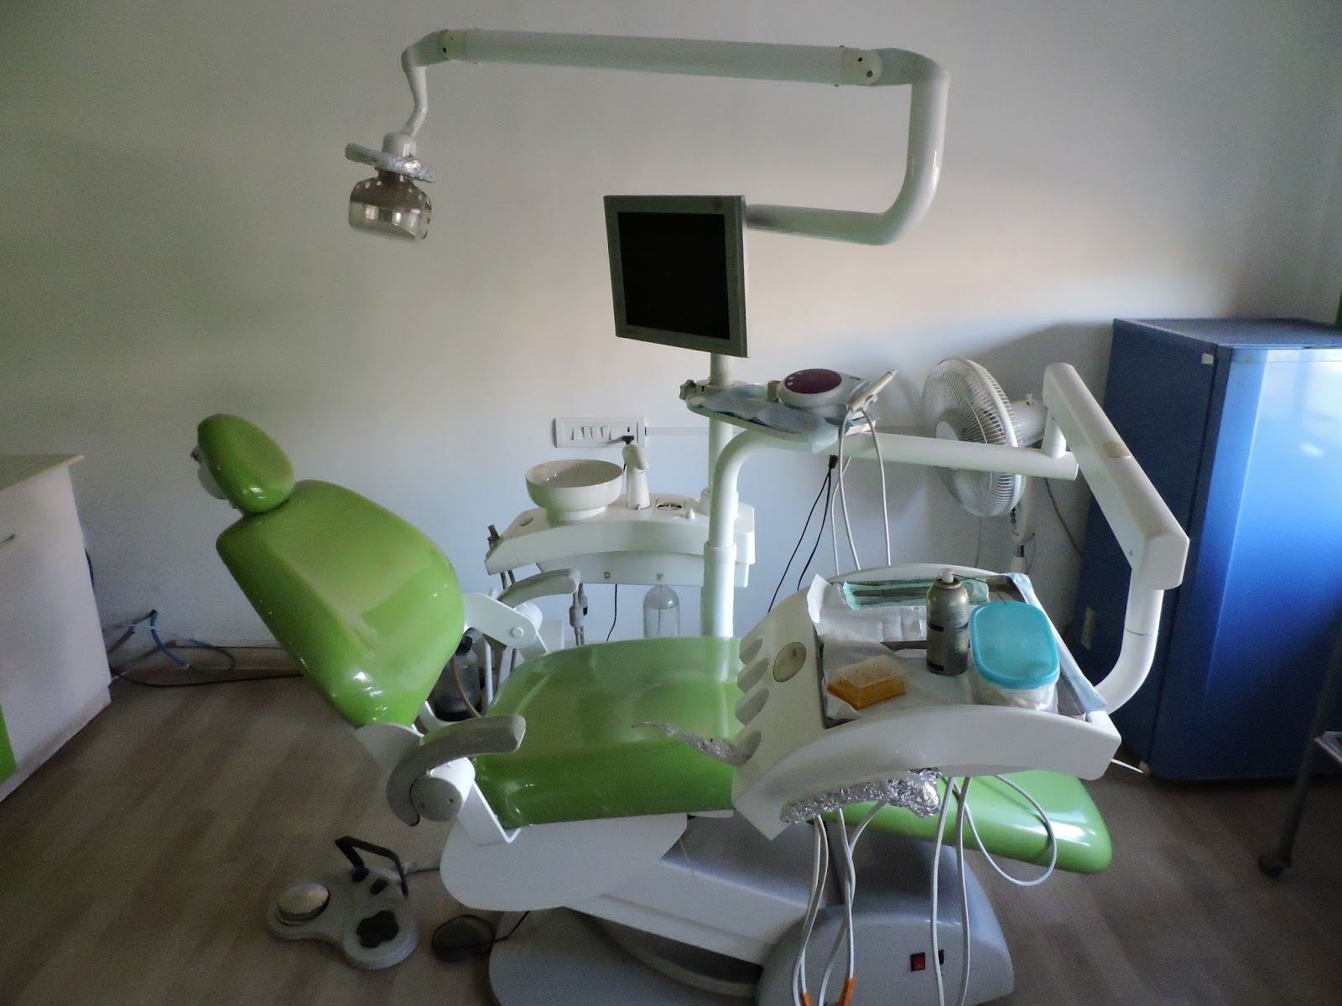
Exemplar: The Dental Environment
“He's got a lot of trauma from childhood, because he had a cleft palate, and obviously underwent quite significant dental work in his early days, which you know the whole, as you were mentioning, the whole association with a dentist is, is very frightening”
Intervention need to:
Recognise environmental challenges for persons living with dementia
Afford opportunities to desensitise to the dental environment and ensure clinic is dementia friendly in lay-out
Consider at home/ care home dental assessments where appropriate
“They had a 2 hour slot on a particular afternoon, where they welcome people with dementia to come into the surgery before they even came for any treatment, just to come and visit the dentist and have a little chat, no treatment, no even looking in your mouth all of that...”
Notes:
One good practice example involved a clinic offering open sessions for persons with dementia to familiarise themselves with the clinic environment without undergoing examination or treatment. This approach helped address common difficulties attending dental surgeries, such as noise, smells, and unfamiliar equipment, which are similar to those experienced by individuals with autism and sensory processing conditions. Another example of good practice was dental professionals performing dental assessments in the care home which is more commonplace in Scotland. Being in a familiar environment helped those with dementia who had physical impairments making it difficult to leave the care home.

Slide 11
Exemplar: Reminders and visual prompts
“So if your focus is on getting someone to brush their teeth, you're making sure that the sink is in front of them and their toothbrush and their toothpaste, so that they see it and think oh, yes, rather than having to think it. So, it is about being in the here and now”
Intervention needs to:
Make good use of routines and visual reminders
Include reminders of HOW to do the activity as well as prompts to do the activity
“It might just be that. you know, getting to the toothbrush, knowing how far away it is from you, knowing how to get something from there to your mouth are all obstacles, so anything that can remove obstacles” about brushing your teeth

Slide 12
Attributes of potential solutions
Flexible to reflect the complexities
Increase carer knowledge and skills
Responsibility for risk assessments
Information sharing
Notes:
Intervention needs to reflect differing dementia types, co-morbidities, previous negative dental experiences, sensory changes or impairments (both dementia and non-dementia related)- flexible to meet the needs of both those living with dementia and those who care for them
One component of intervention needs to focus on caregiver knowledge and skills, improve confidence, facilitate good ideas and practices between carers (often working in isolation)
Promote information sharing between agencies involved- health and social care AND dentistry- carers spoke of issues trying to navigate the health,social and dental systems, burden of remembering info for another agency who has no access to that, and sometimes carers being denied health information due to data protection.
In relation to the original idea of an electronic risk assessment, originally perceived to be undertaken remotely by caregivers, this was not supported by carers- the tool was a good idea but should be completed by a professional- caregivers felt their role in this intervention was to better support preventative health, not assess risk.
Additionally, information sharing gaps regarding oral health and mouthcare between healthcare providers, care homes, and families disrupted coordinated care, leading to incomplete care packages and care instability. Carers highlighted the importance of enhancing communication between dental and healthcare professionals to prevent the need for repetitive information from caregivers. They expressed concerns about their own ability to effectively share crucial information between the two professional services. Questions were therefore raised about the current lack of integration between dental records and general health records, emphasising the need for more cohesive information sharing.

Slide 13
Intervention Logic Model

Slide 14
Next steps
Activities
Feasibility/ programme grant - Refining the prototype and explore components such as information sharing and HCP training needs
Clarify where and for who this intervention can be tested
Explore the system where it will be implemented - how could dental services and caregiver support be improved
What resources/interventions have already been developed
NIHR RfPB
Community
Notes:
Key activities- Obtain feasibility/ programme grant funding to refine the prototype, explore components such has data sharing further, clarify who/ where, wider implementation issues (such as access to dental services, addressing current challenges in obtaining dental care for persons living with dementia), and systematically identify resources already developed which can be brough into the design of this intervention.

Slide 15
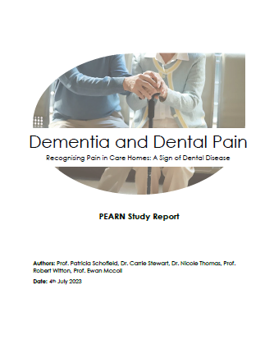
Questions?
“…this this is an important project that I think can add a great deal of value… and if it eases suffering and pain, and it improves the quality of life a little bit more, then it’s worthwhile, and I pursue it to the end of the earth. Thank you for what you're doing.”
Email: Carrie.stewart@abdn.ac.uk

